Slide 1


Temporal-Difference Learning
Hongning Wang
CS@THU

Slide 2
Outline
TD prediction
On-Policy TD control: Sarsa
Off-Policy TD control: Q-Learning
n-step TD methods

Slide 3
Advantages of the RL methods we have learnt?
Monte Carlo methods
  Model-free
  Evaluation of one state is independent from evaluation on other states – less dependency on Markovian property
  Unbiased
Dynamic programming
  Model-based
  Guarantee to converge to optimal
  Exponential convergence

Slide 4
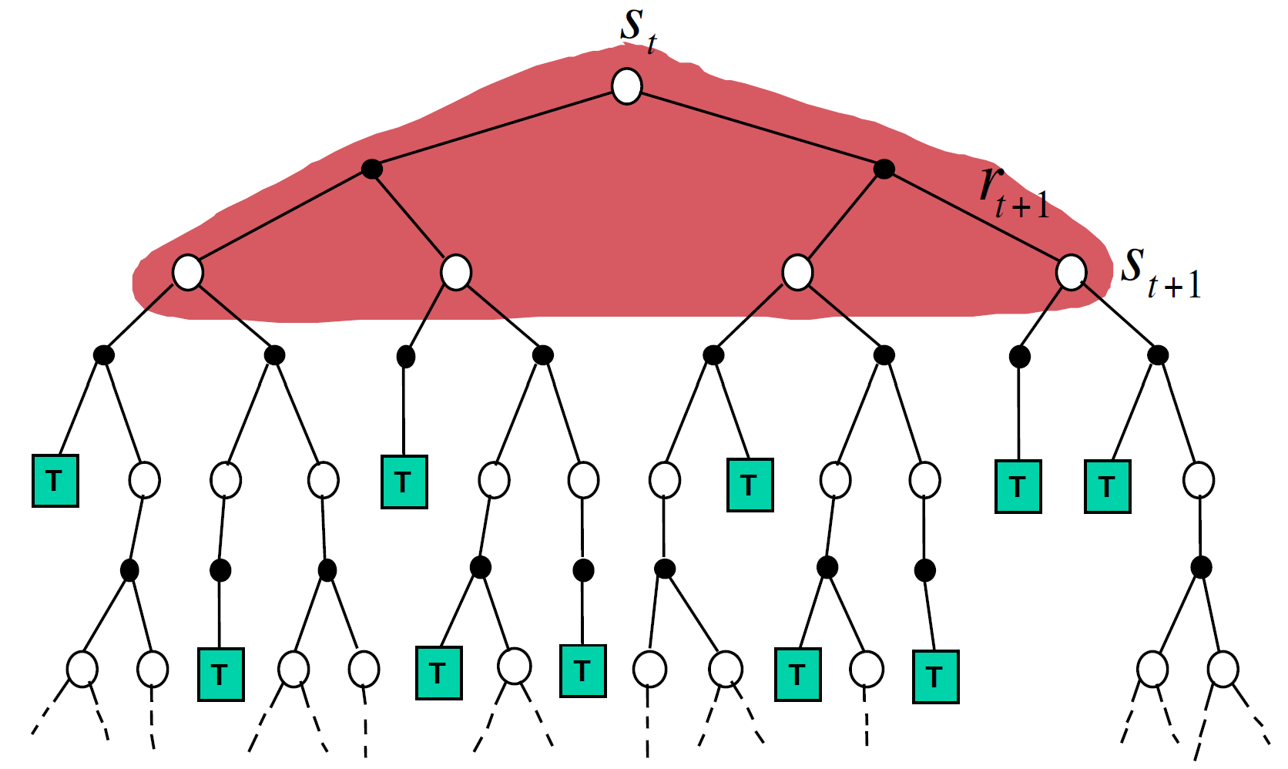
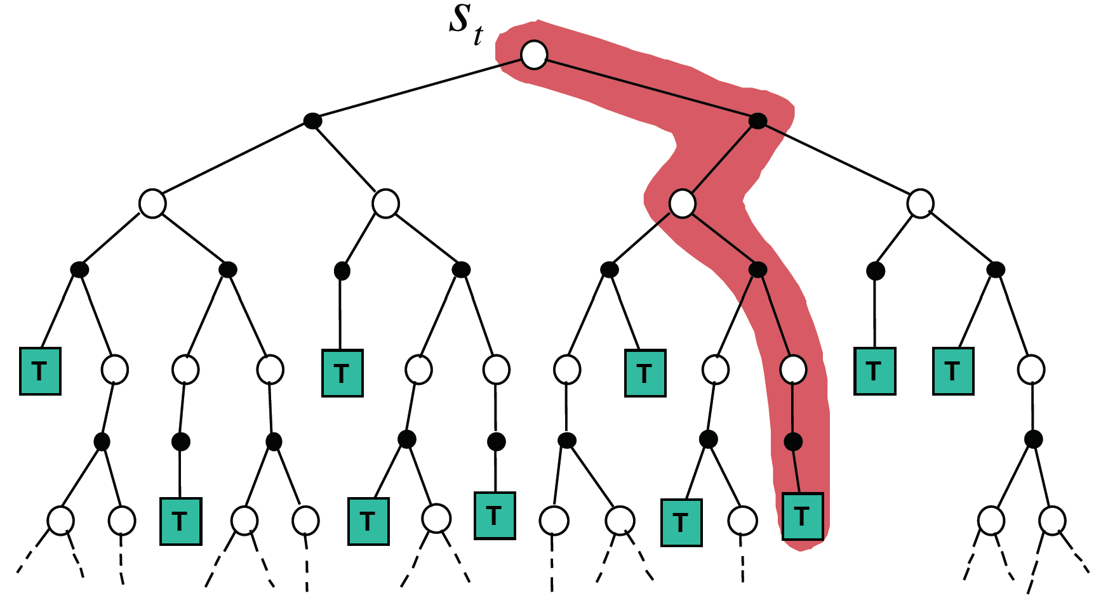
Limitations of the RL methods we have learnt?
Monte Carlo methods
  Update per episode - only works in episodic environments
  High variance
Dynamic programming
  Require complete knowledge of the environment
Figure credit: David Silver, “Model-Free Prediction”

Slide 5




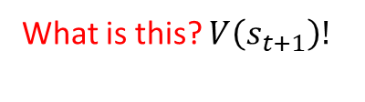
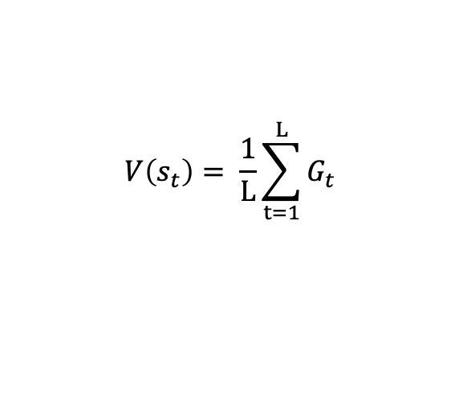
Temporal difference methods
Incremental mean update:
$$μ_{k}=\frac{1}{k}\sum_{i=1}^{k}{x_{i}}=\frac{1}{k}\left(x_{k}+\sum_{i=1}^{k−1}{x_{i}}\right)$$
$=\frac{1}{k}\left(x_{k}+\left(k−1\right)u_{k−1}\right)$
$=μ_{k−1}+\frac{1}{k}\left(x_{k}−u_{k−1}\right)$
A method in between DP and MC
  Policy evaluation to begin with
    MC: $V\left(s_{t}\right)← V\left(s_{t}\right)+α[G_{t}−V\left(s_{t}\right)]$
    DP: $V(s_{t})=R_{π}+γP_{π}^{ss^{′}}V(s_{t})$
    $$V\left(s_{t}\right)= \frac{1}{L}\sum_{t=1}^{L}{G_{t}}$$
A shrinking coefficient
Boot-strap the calculation
Need an entire episode
$${G_{t}=R}_{t+1}+γR_{t+2}+γ^{2}R_{t+3}+…+γ^{T−1}R_{T}$$
    What is this? $V\left(s_{t+1}\right)!$
Vs. MC?
$${G_{t}\dot{=}R}_{t+1}+γV(s_{t+1})$$
Vs. DP?
From the environment
Essentially, this is boot-strapping!
TD(0):
    $$V\left(s_{t}\right)← V\left(s_{t}\right)+α[R_{t+1}+γV(s_{t+1})−V\left(s_{t}\right)]$$
From current value estimate

Slide 6
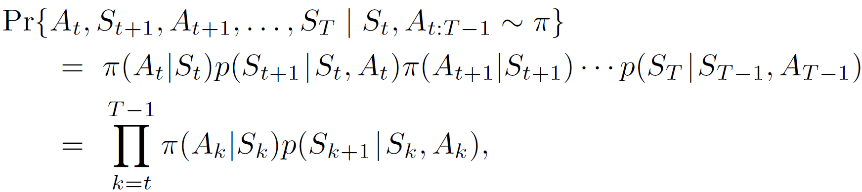
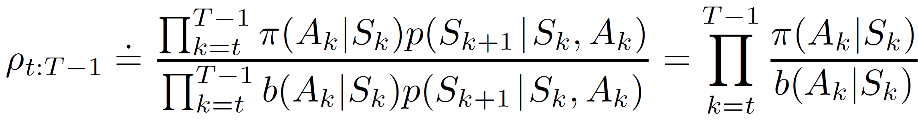
Recap: off-policy MC evaluation
Use importance sampling to reweigh experiences
  As the environment follows an MDP
  The importance weight is the product of the series of actions under two policies
Source of large variance!

Slide 7
Recap: temporal difference methods
Incremental mean update:
$$μ_{k}=\frac{1}{k}\sum_{i=1}^{k}{x_{i}}=\frac{1}{k}\left(x_{k}+\sum_{i=1}^{k−1}{x_{i}}\right)$$
$=\frac{1}{k}\left(x_{k}+\left(k−1\right)u_{k−1}\right)$
$=μ_{k−1}+\frac{1}{k}\left(x_{k}−u_{k−1}\right)$
A method in between DP and MC
  Policy evaluation to begin with
    MC: $V\left(s_{t}\right)← V\left(s_{t}\right)+α[G_{t}−V\left(s_{t}\right)]$
    DP: $V(s_{t})=R_{π}+γP_{π}^{ss^{′}}V(s_{t})$
A shrinking coefficient
Boot-strap the calculation
Need an entire episode
$${G_{t}=R}_{t+1}+γR_{t+2}+γ^{2}R_{t+3}+…+γ^{T−1}R_{T}$$
    What is this? $V\left(s_{t+1}\right)!$
Vs. MC?
$${G_{t}\dot{=}R}_{t+1}+γV(s_{t+1})$$
Vs. DP?
From the environment
Essentially, this is boot-strapping!
TD(0):
    $$V\left(s_{t}\right)← V\left(s_{t}\right)+α[R_{t+1}+γV(s_{t+1})−V\left(s_{t}\right)]$$
From current value estimate

Slide 8
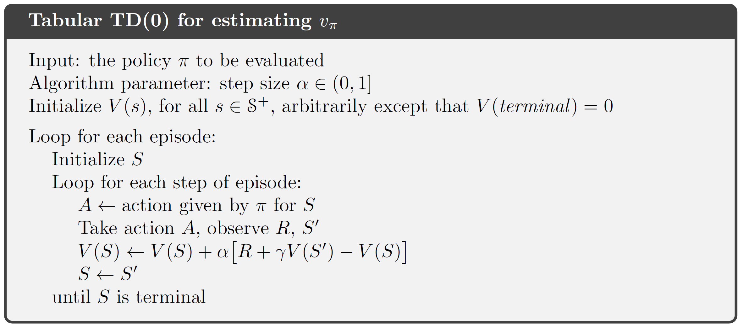
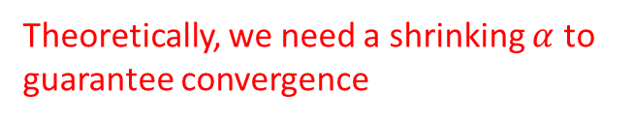
TD(0)
One-step temporal difference
A constant?
Theoretically, we need a shrinking $α$ to guarantee convergence
TD update is a correction based on TD error
TD error

Slide 9
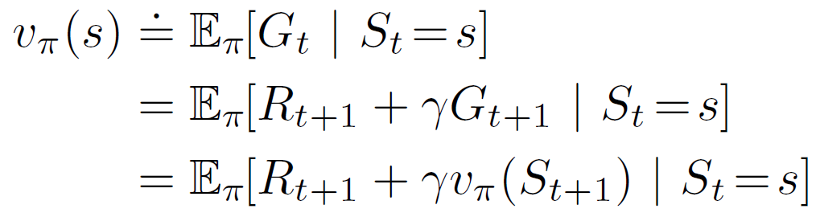
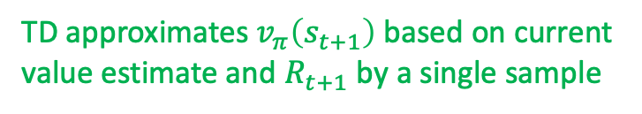
TD vs., MC vs., DP
They all do approximations, but in different components
MC approximates expectation by sampling
DP approximates $v_{π}\left(s_{t+1}\right)$ based on current value estimate
TD approximates $v_{π}\left(s_{t+1}\right)$ based on current value estimate and $R_{t+1}$ by a single sample

Slide 10
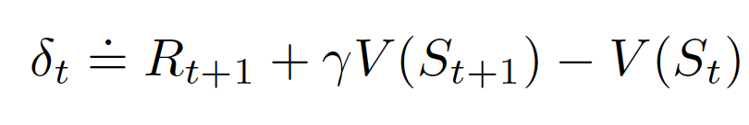
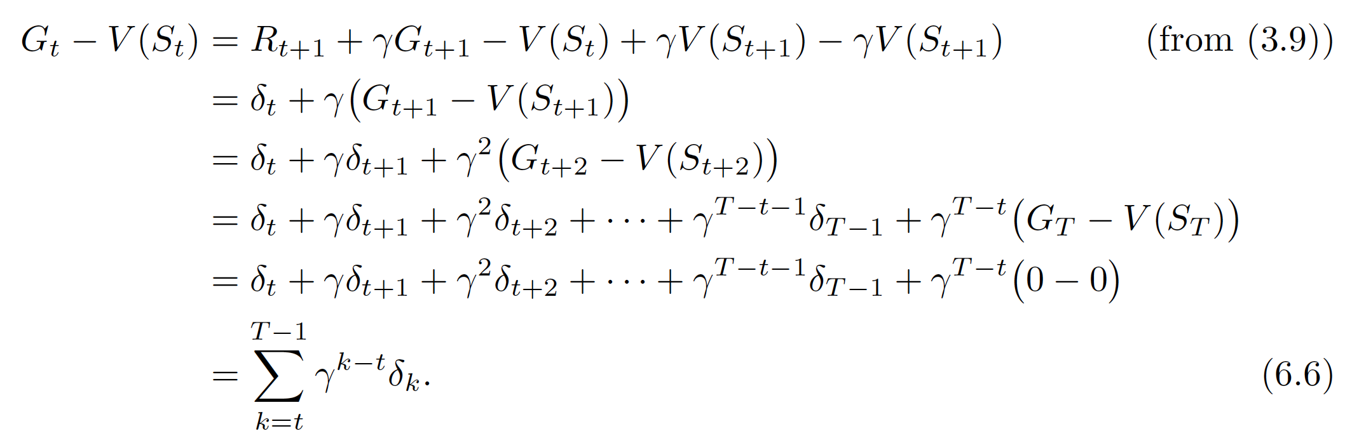
TD error
Define
Monto Carlo error is an accumulation of TD error
  Assuming no update before the end of episode

Slide 11
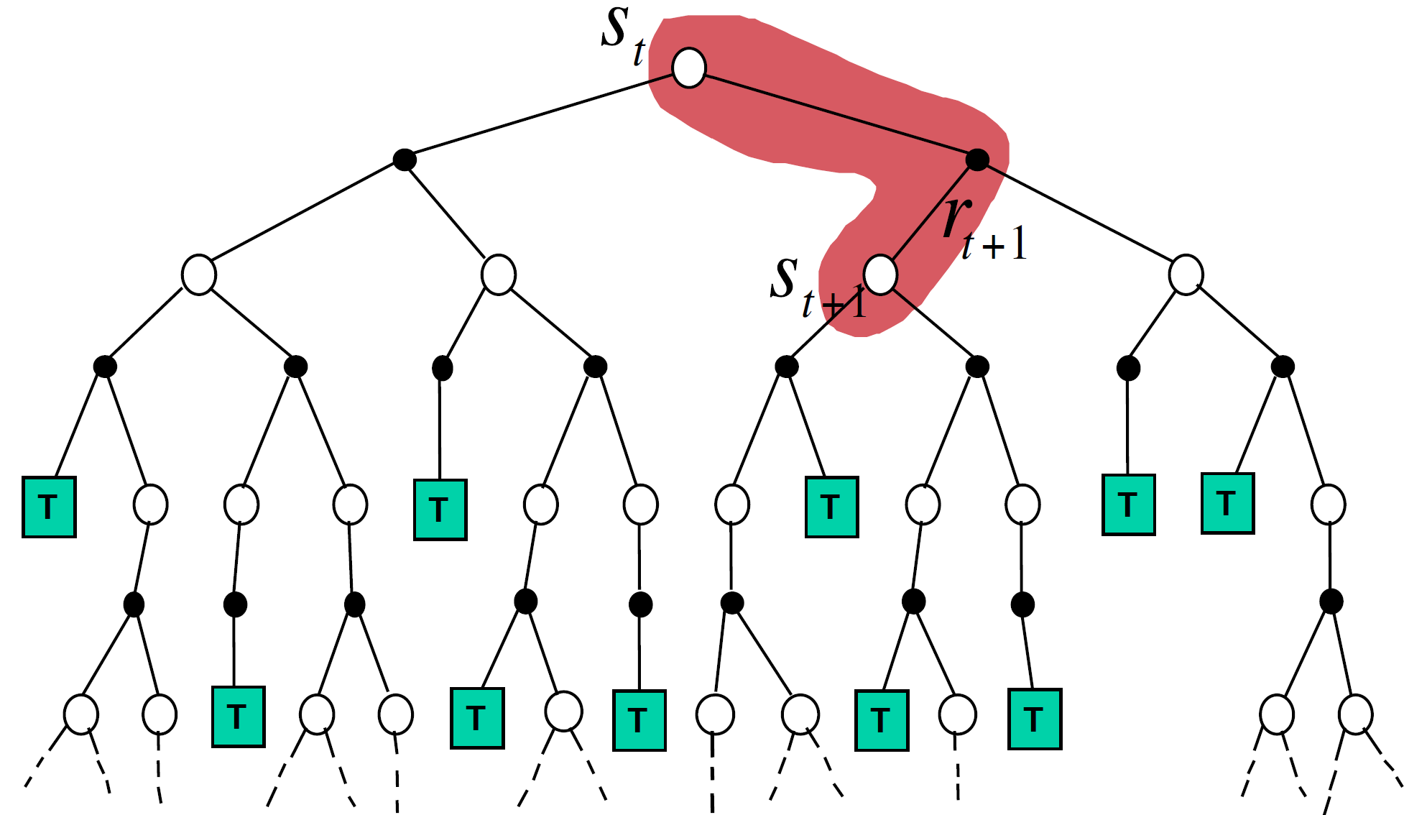
Backup diagram
TD: sampling + bootstrapping

Slide 12
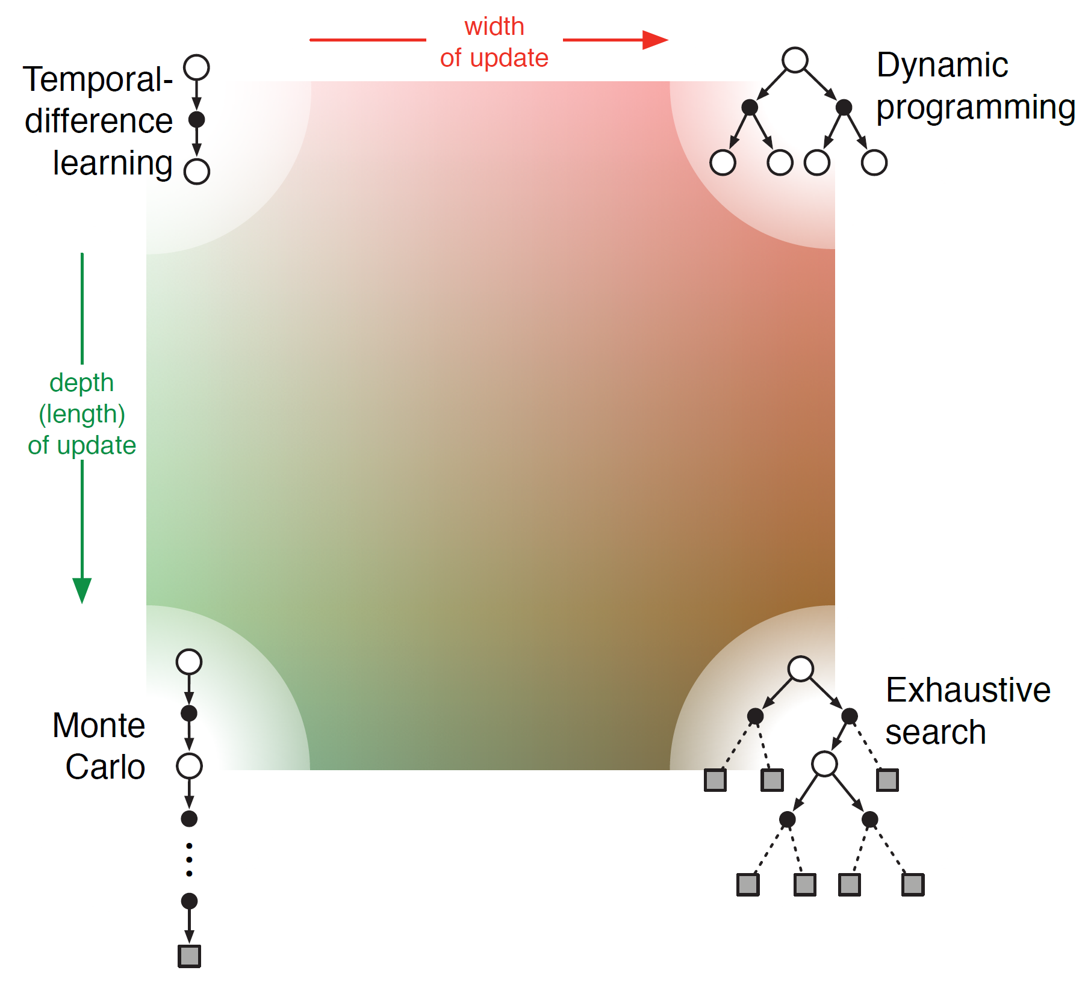
A unified view of RL methods
Pros and cons of different methods?

Slide 13
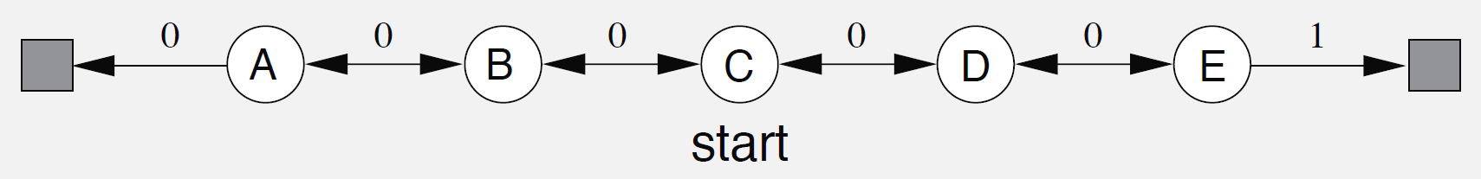
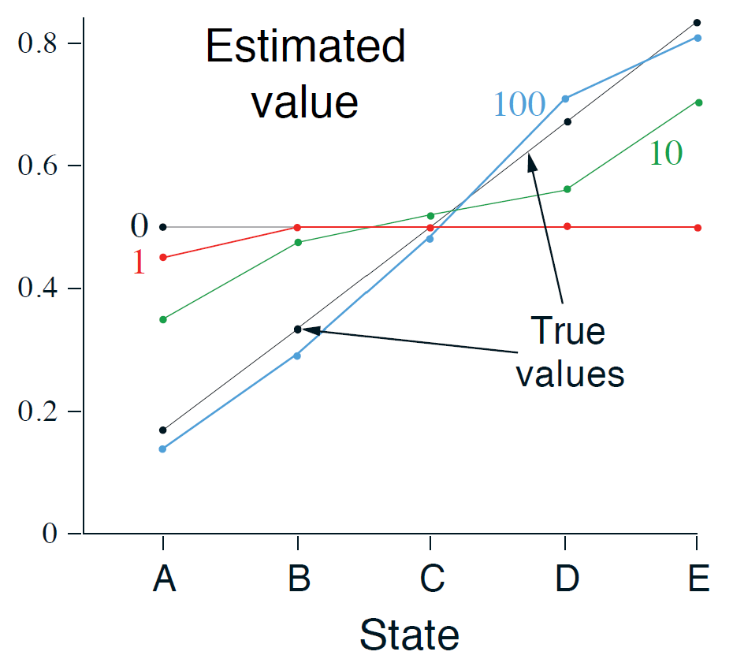
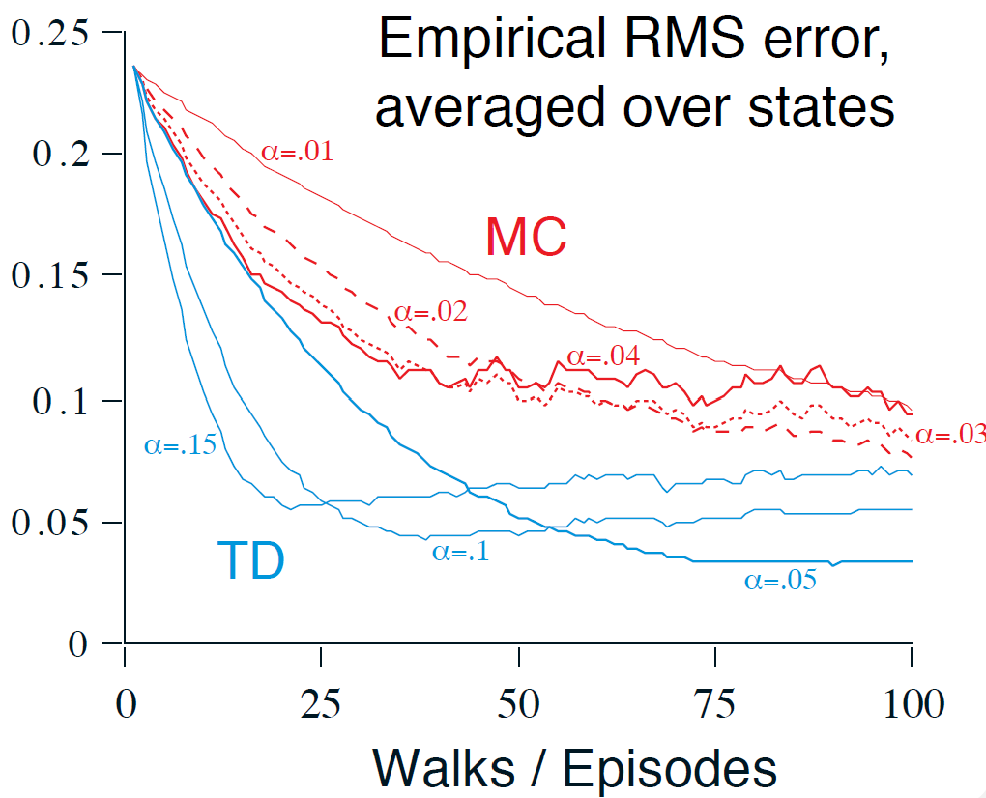
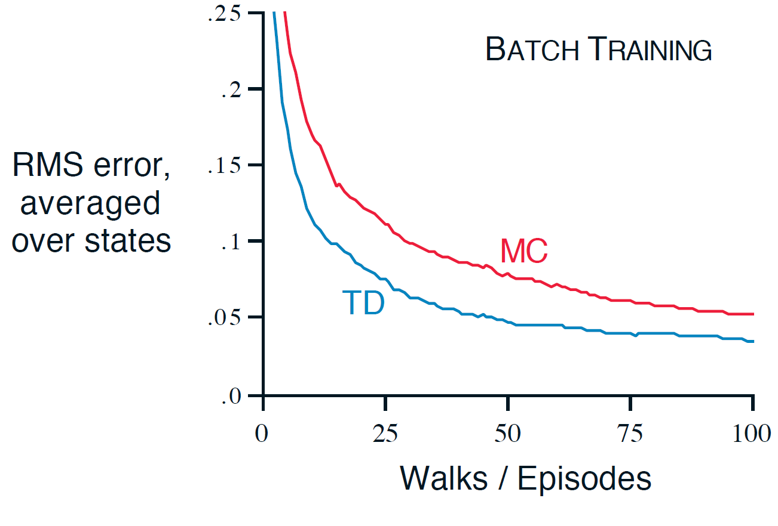






TD vs., MC in a toy example: random walk
How to?
$$1/6$$
$$2/6$$
$$3/6$$
$$4/6$$
$$5/6$$
$$γ=1$$
all episode accumulated so far

Slide 14
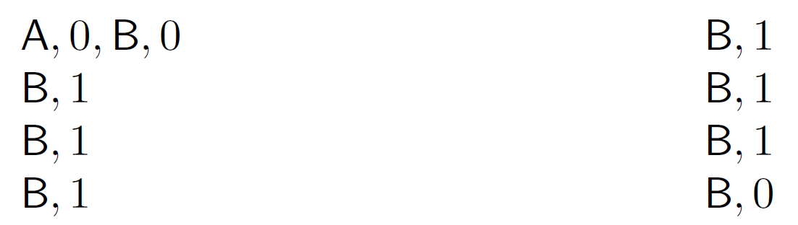




Optimality of batch TD vs., batch MC in a toy example
Given the following experiences from 8 episodes:
Set $γ=1$
$V\left(A\right)=0$ or $6/8$
$$V\left(B\right)=6/8$$
Batch MC minimizes mean square error on training set
Batch TD minimizes negative log-likelihood under Markov process model
MC’s perspective
TD’s perspective

Slide 15
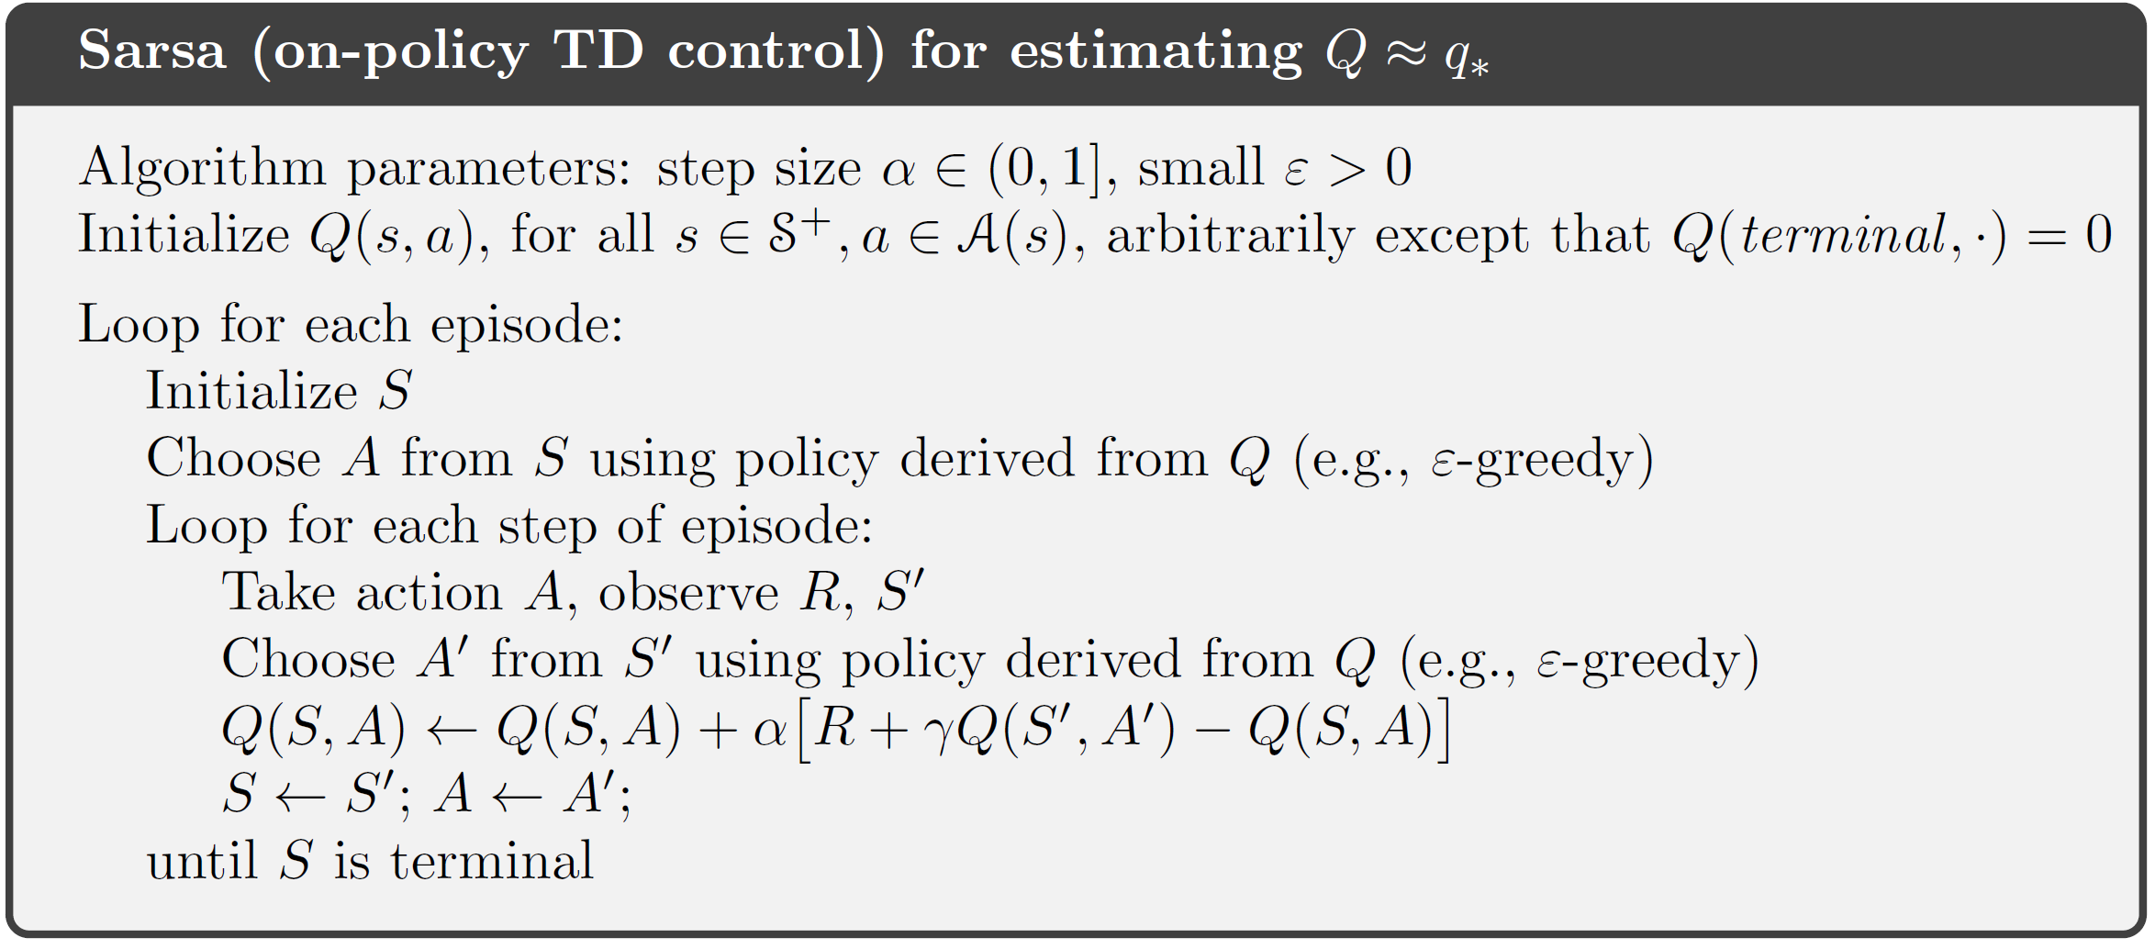
On-Policy TD control: Sarsa
Learning the action value function using TD method
  Exploration? Everything we have learnt about it applies here!
why is this?

Slide 16
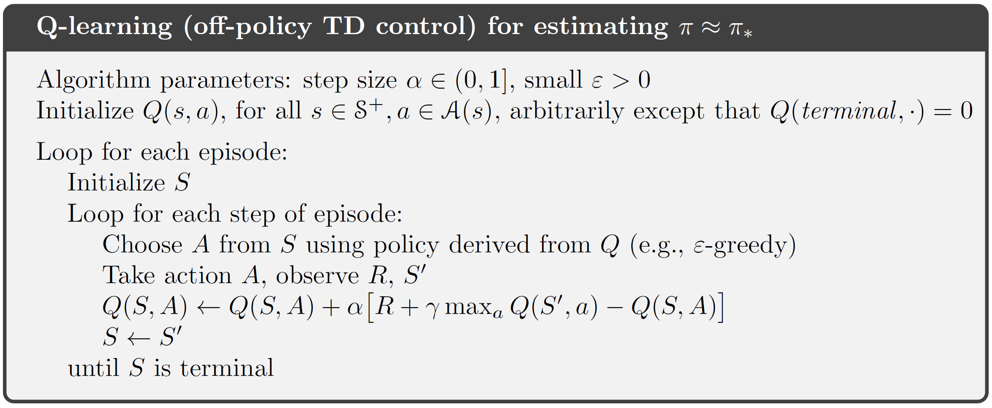
Off-Policy TD control: Q-learning

Slide 17
Sarsa vs., Q-learning
Why is it off-policy?
greedy!

Slide 18
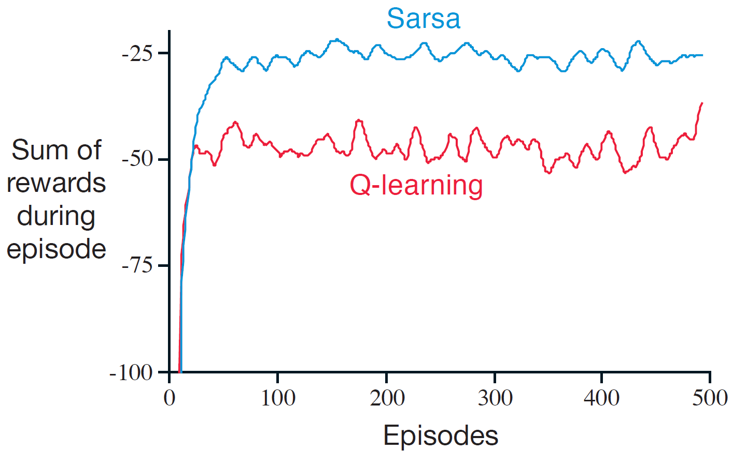
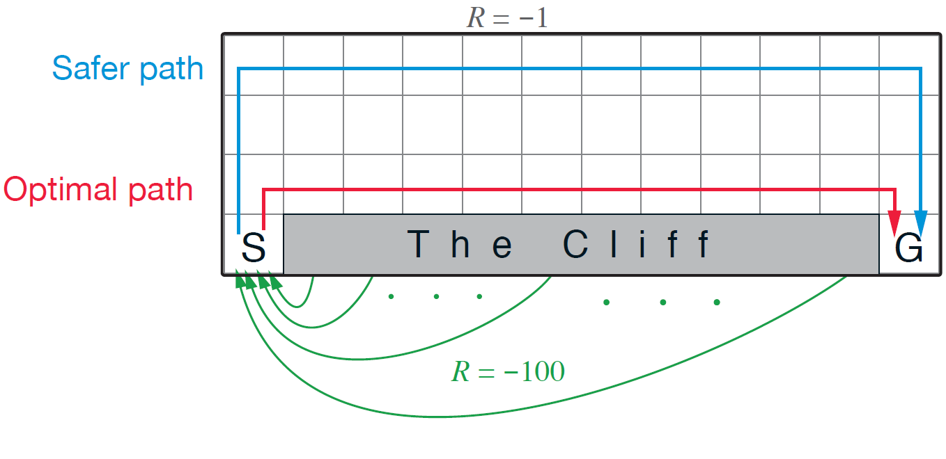

Sarsa vs., Q-learning in a toy example
why would it be worse?
$$γ=1$$
Randomness comes from policy, rather than environment in this example!

Slide 19
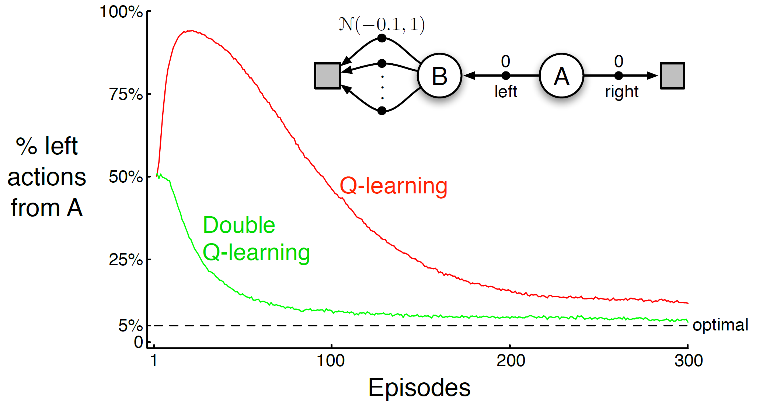
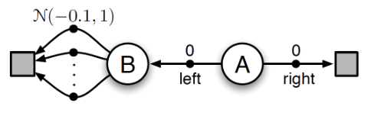

Maximization bias
We use maximum to choose an action and also treat it as an estimate of the maximum of the true value
  Q-learning as an example
$$γ=1$$

Slide 20
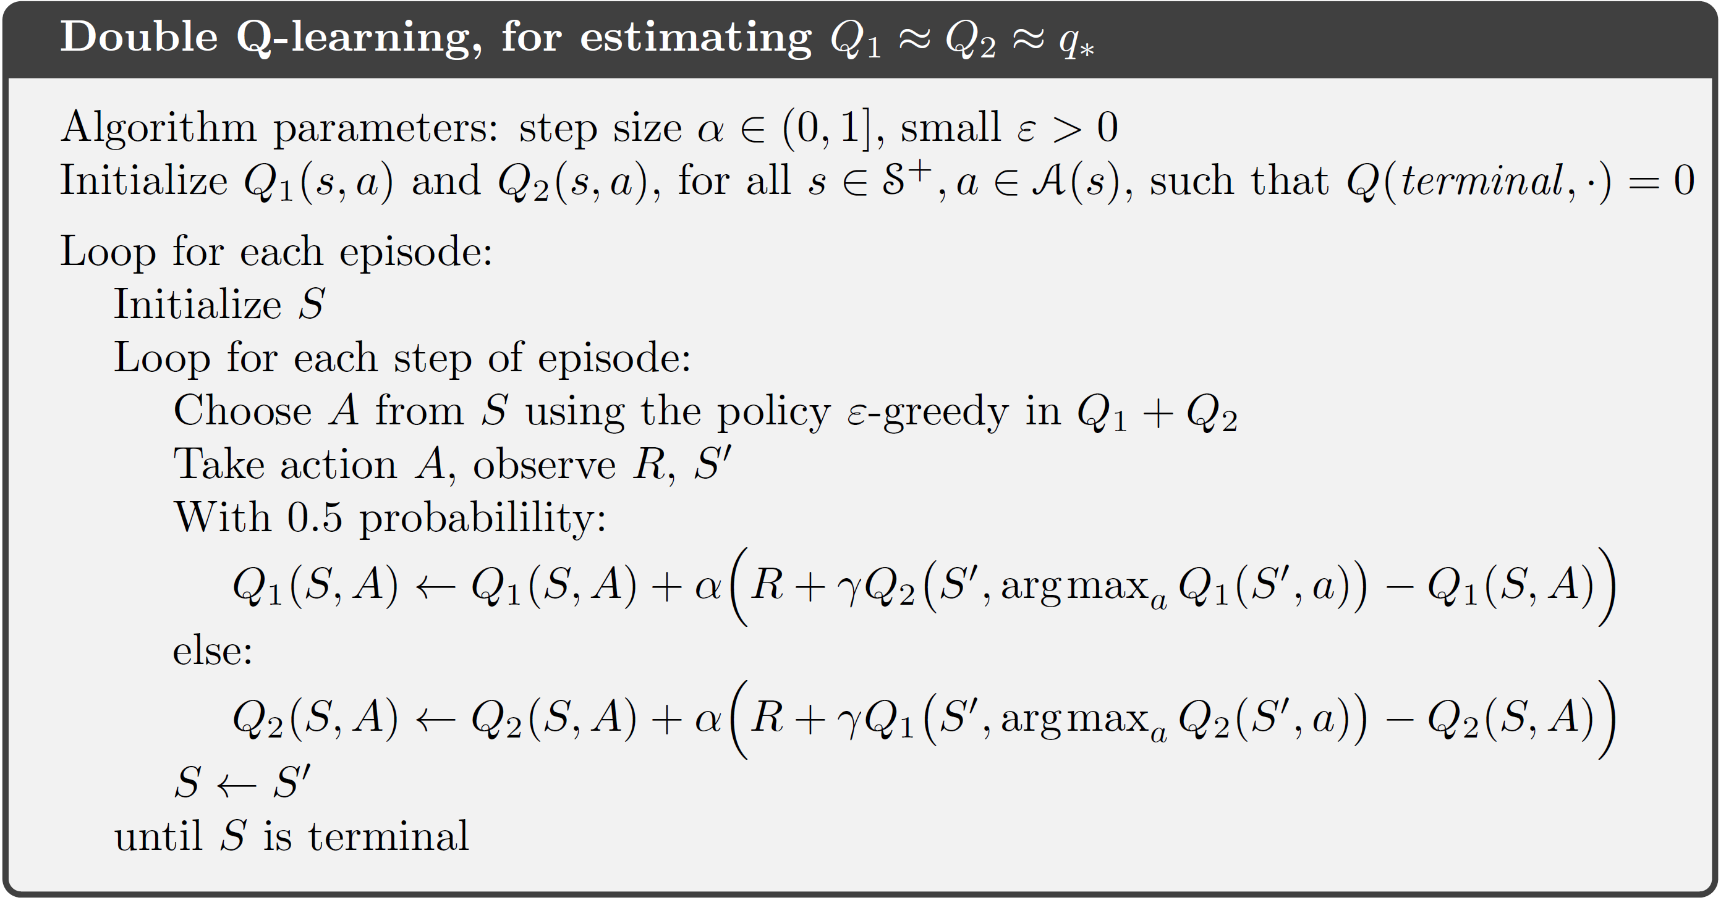
Double Q-learning
Unbiased estimate for each other!

Slide 21
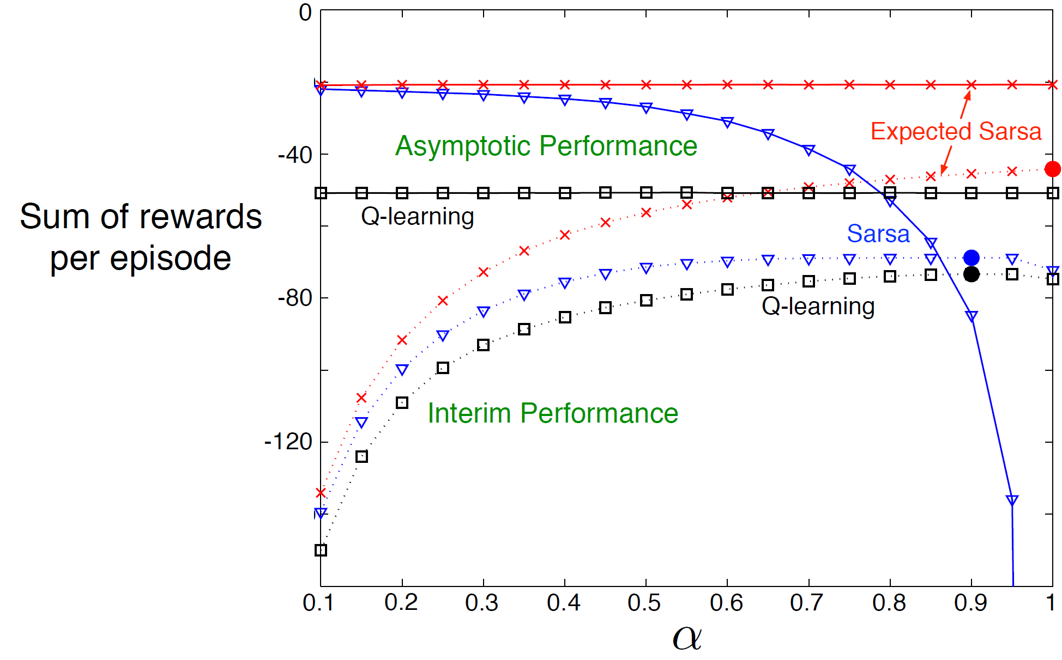
Expected Sarsa
Instead of sampling one action for the next state, compute the expectation
Is this on-policy or off-policy?
100k episodes
Slightly better than Sarsa
100 episodes

Slide 22



n-step temporal difference methods
A method in between DP and MC
  Policy prediction to begin with
    MC: $V\left(s_{t}\right)← V\left(s_{t}\right)+α[G_{t}−V\left(s_{t}\right)]$
    DP: $V(s_{t})=R_{π}+γP_{π}^{ss^{′}}V(s_{t})$
Everything here is known and immediately used
Need an entire episode
$${G_{t}=R}_{t+1}+γR_{t+2}+γ^{2}R_{t+3}+…+γ^{T−1}R_{T}$$
    What is this? $V\left(s_{t+2}\right)!$
We have to wait one more step!
$${G_{t}\dot{=}R}_{t+1}+γR_{t+2}+γ^{2}V(s_{t+2})$$
From the environment
TD(1):
    $$V\left(s_{t}\right)← V\left(s_{t}\right)+α[R_{t+1}+γR_{t+2}+γ^{2}V(s_{t+2})−V\left(s_{t}\right)]$$
From current value estimate

Slide 23
n-step temporal difference methods
A more flexible way to strike a balance between TD and MC
n-step sampled return
bootstrapping
no update until we collect n samples!

Slide 24
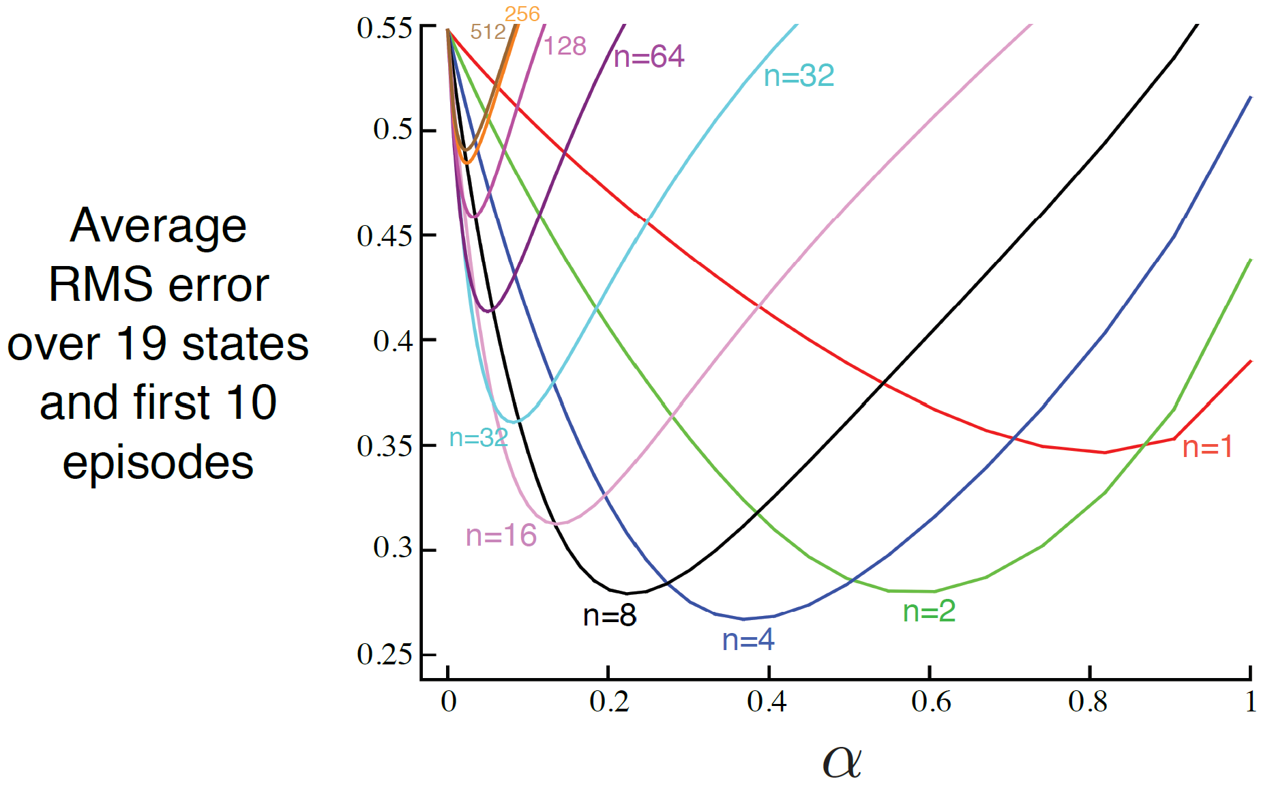
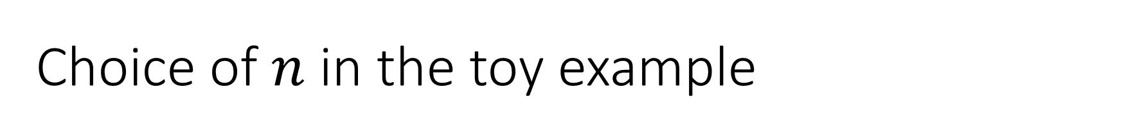
Choice of $n$ in the toy example
$$γ=1$$
Policy prediction task

Slide 25
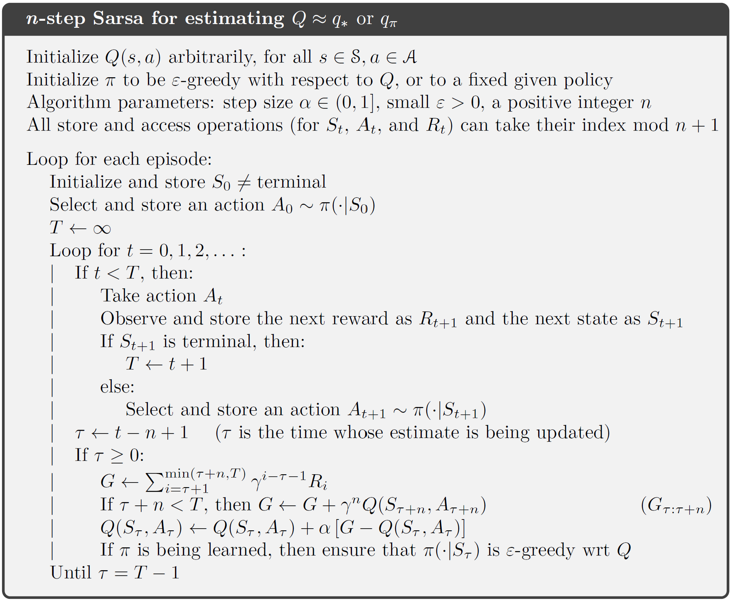
n-step Sarsa
length-n window to collect samples

Slide 26
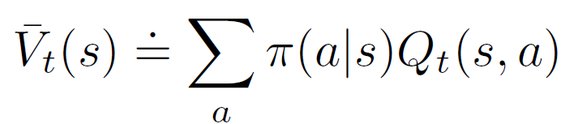

n-step Sarsa
n-step return is a series of TD corrections
n-step excepted Sarsa
Discount for time $t+k$
predicted value of $A_{t}$ at $S_{t}$ at time $t$
TD error/correction of $A_{t+k}$ at $S_{t+k}$ at time $t+k$

Slide 27
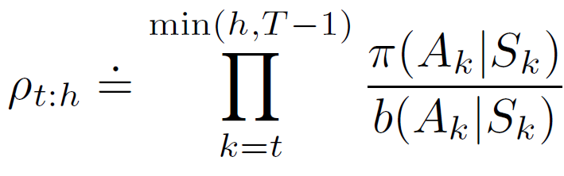
n-step off-policy learning
The same principle as in episodic off-policy MC
Techniques used in off-policy MC for controlling variance of this weight also apply here
Discounting-aware importance sampling
Per-decision importance sampling
How about n-step Q-learning??

Slide 28
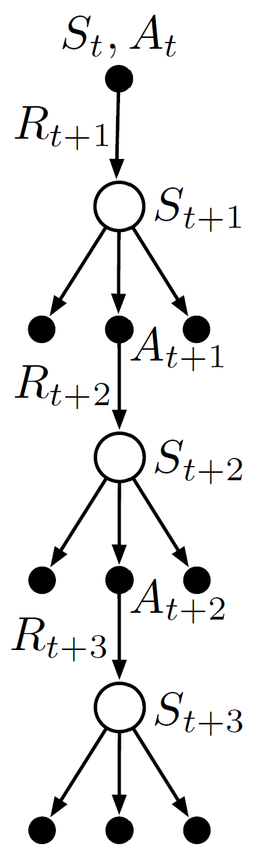
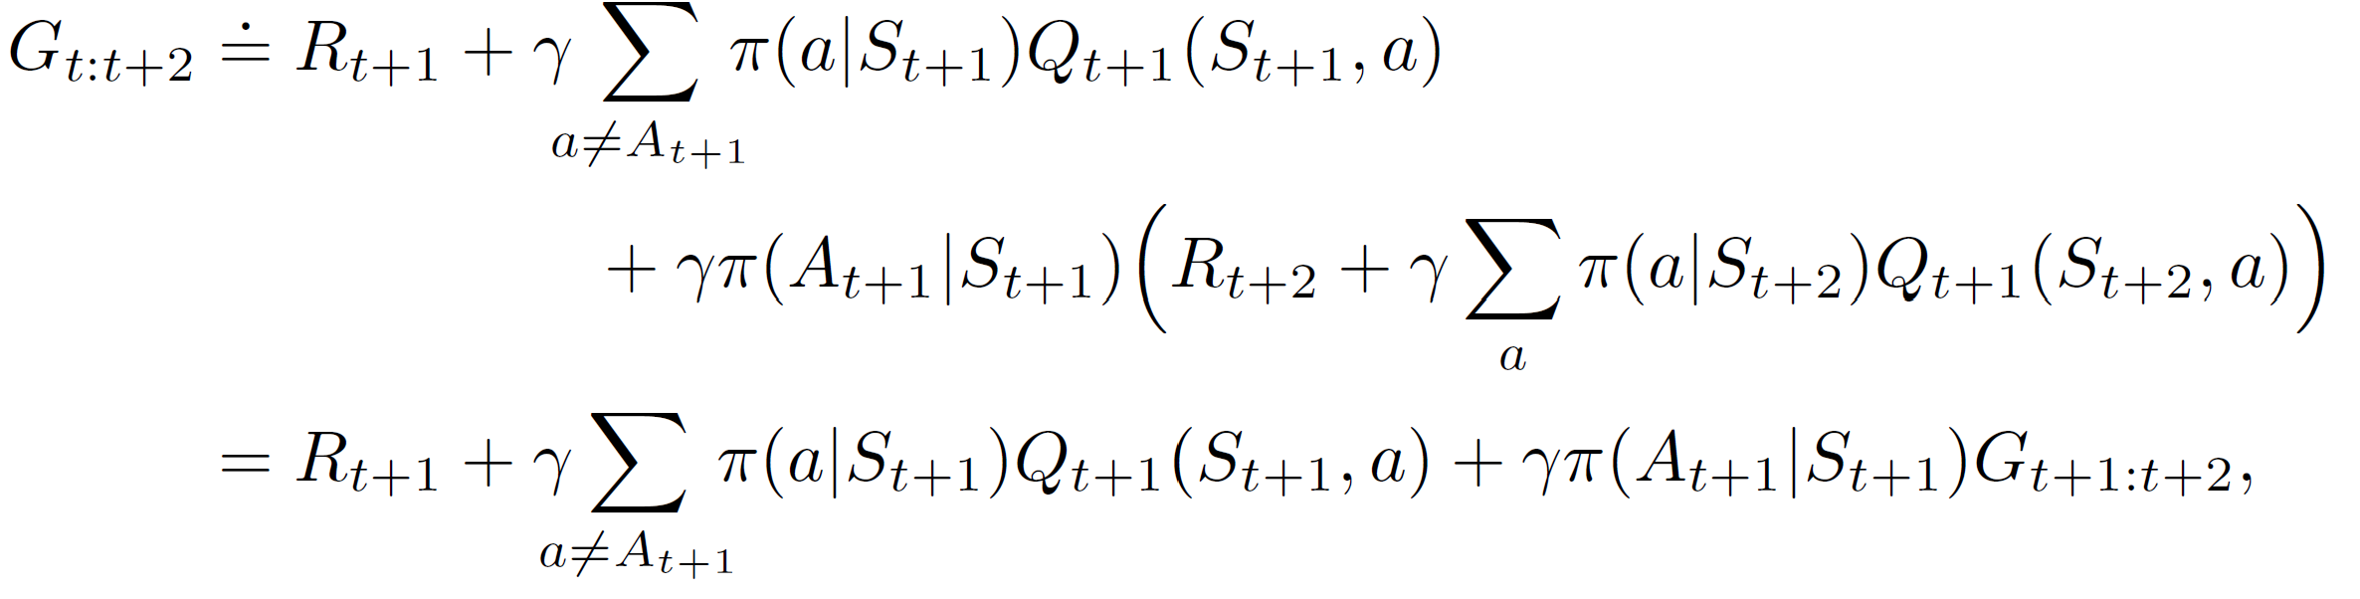

n-step off-policy learning: Tree Backup
Without importance sampling
  One-step: Q-learning, expected Sarsa
We have sampled observations (e.g., from behavior policy)
Kind of expected Sarsa
We do not have any observations;
use current estimate instead!
by definition, recursion appears!
Why is it an off-policy method?

Slide 29

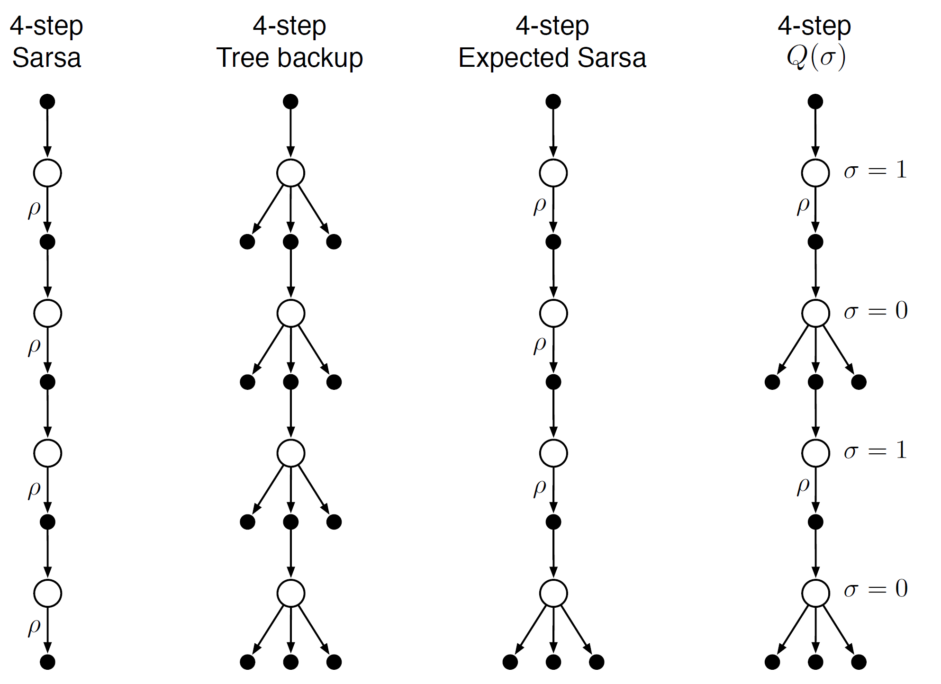
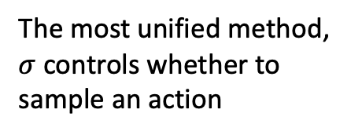
Unifying all n-step TD methods
The most unified method, $σ$ controls whether to sample an action
off-policy correction

Slide 30
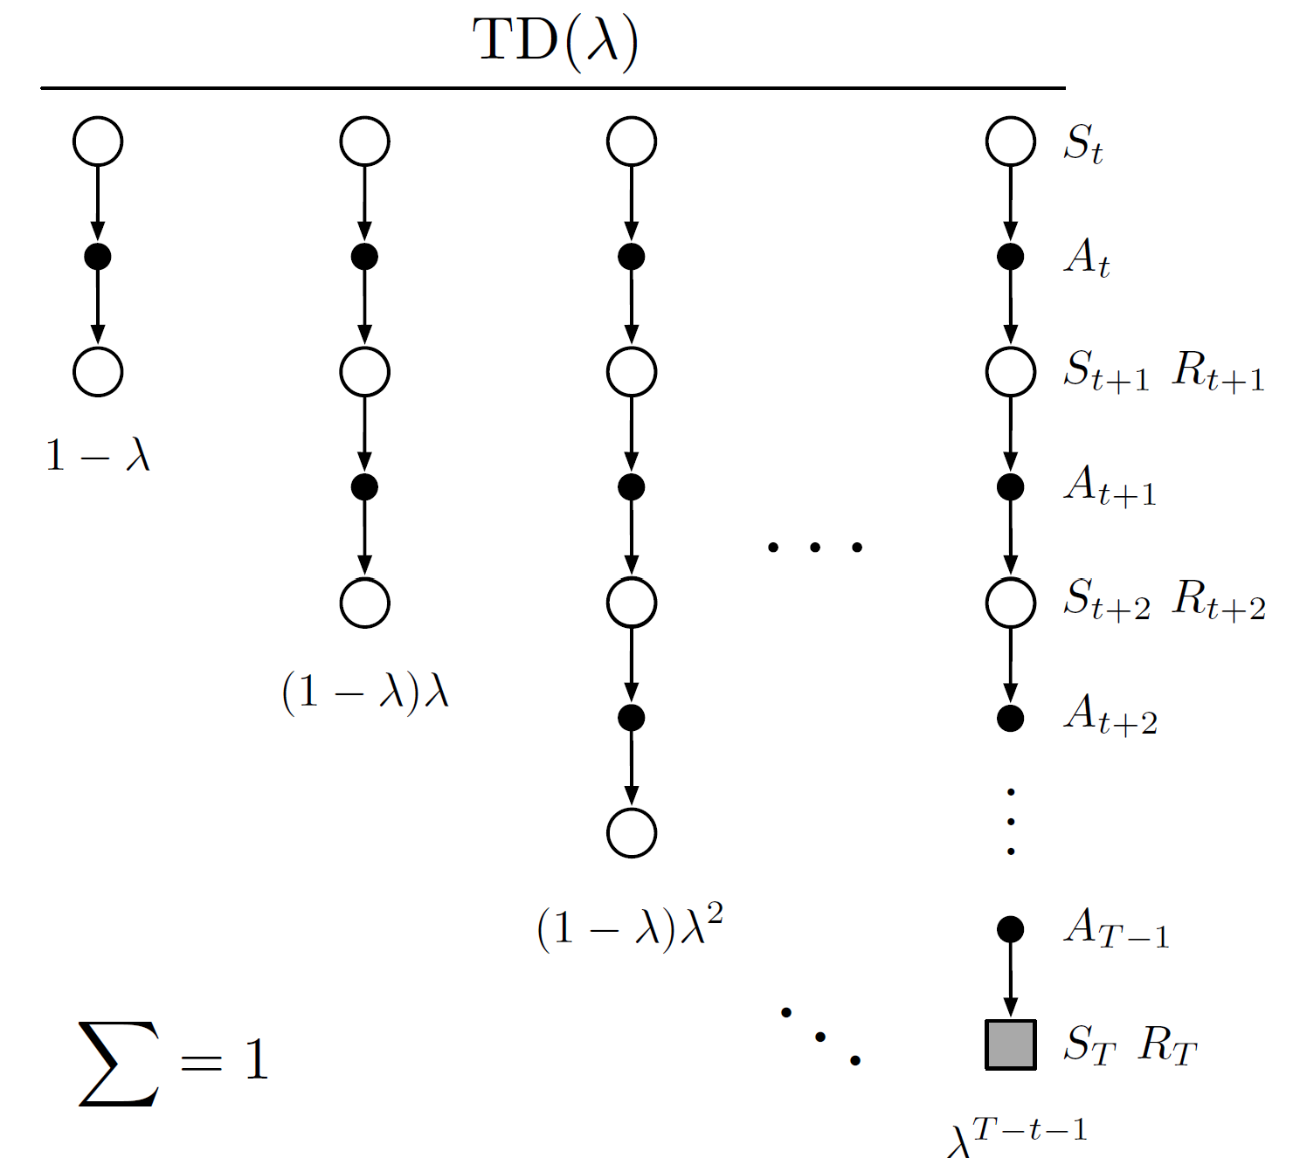
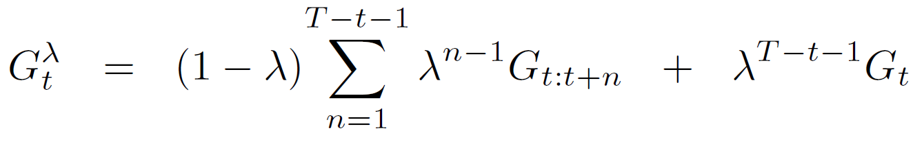

Unifying n steps in TD methods
Do we have to wait until n steps for a valid update?
$λ$-return:
Soft version of n-step return, without explicit n
Weight the return so far

Slide 31
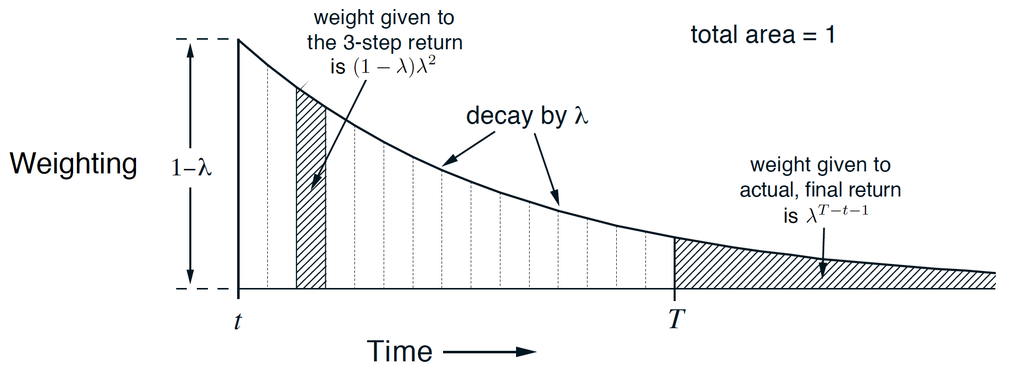
Unifying n steps in TD methods
We do not have to wait until n steps for a valid update!
$λ$-return:
Soft version of n-step return, without explicit n

Slide 32
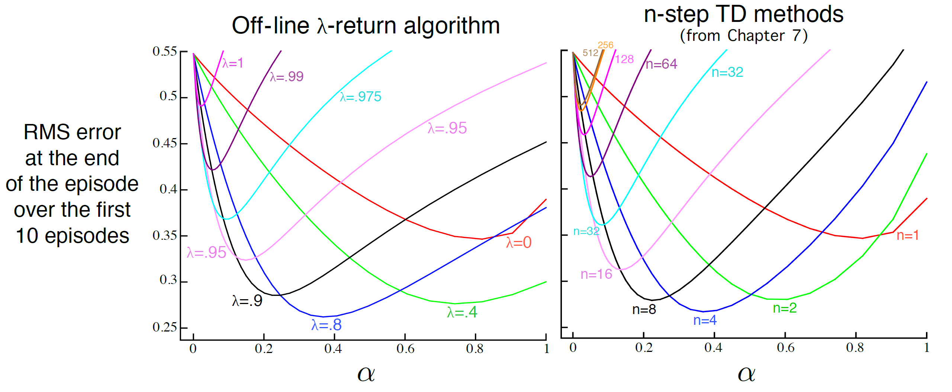
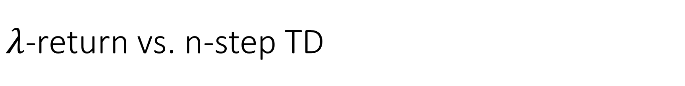

$λ$-return vs. n-step TD
$$γ=1$$

Slide 33
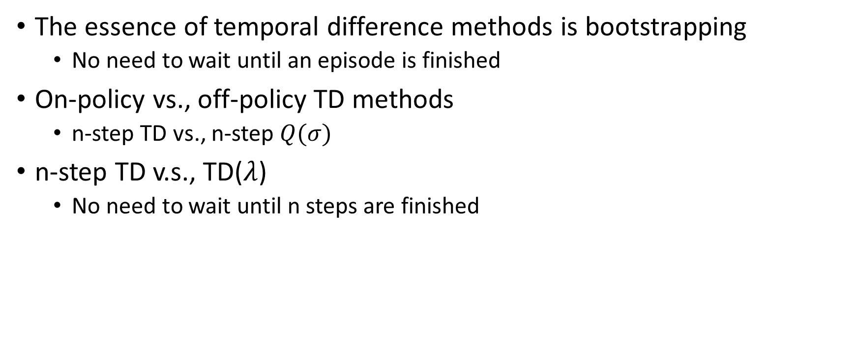
Takeaways
The essence of temporal difference methods is bootstrapping
  No need to wait until an episode is finished
On-policy vs., off-policy TD methods
  n-step TD vs., n-step $Q(σ)$
n-step TD v.s., TD($λ$)
  No need to wait until n steps are finished

Slide 34
Suggested readings
Chapter 6: Temporal-Difference Learning
Chapter 7: n-step Bootstrapping
Chapter 12: Eligibility Traces

